Slide 1

Practice Your Programming with Katas
Session 6: 数独

Slide 2

Week 6: http://eca-katas/session6
Write a function that verifies if a given grid of characters is a valid (partial or complete) Sudoku solution. Hint: read the unit tests before you start
Grids are supplied as a list (each row in the grid is an item in the list)
Empty squares are denoted by a space or a null.
There should be no more than 9 characters used in the solution (except spaces)
To be a valid grid it must be a 9x9 grid with no repeats (except spaces):
In each horizontal and vertical line
In each of the 9 3x3 sub-grids
Your function should return True if the grid is valid, False otherwise

Slide 3
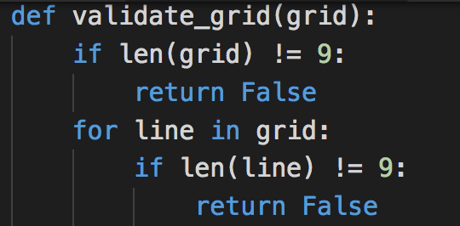
Is it a 9x9 Square?

Slide 4
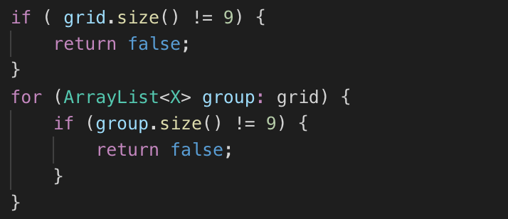
Is it a 9x9 Square?

Slide 5
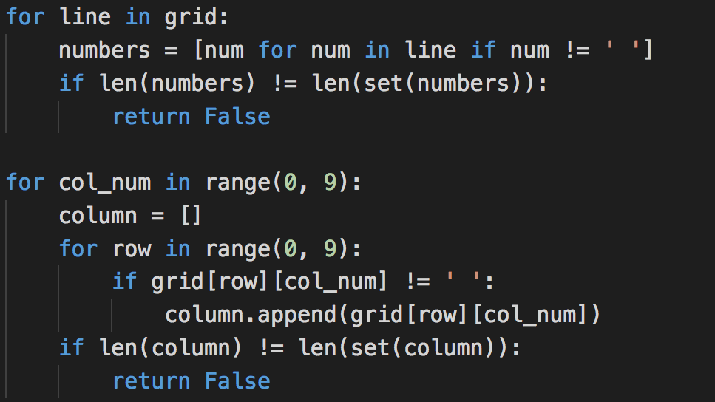
Is each row and column valid?

Slide 6
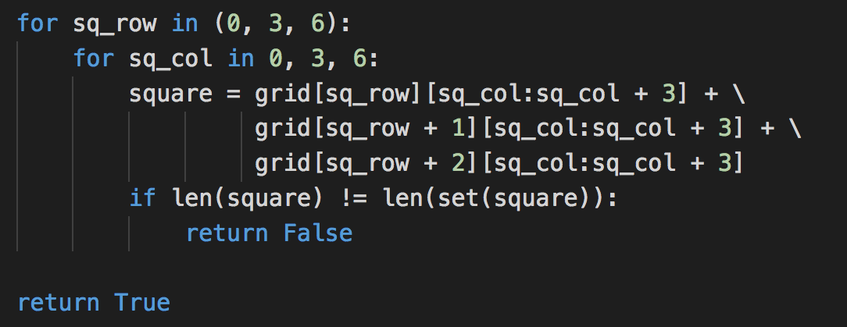
Is each 3x3 square valid?
Notes:
Warning: redundant brackets!

Slide 7
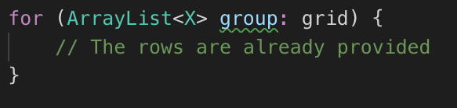
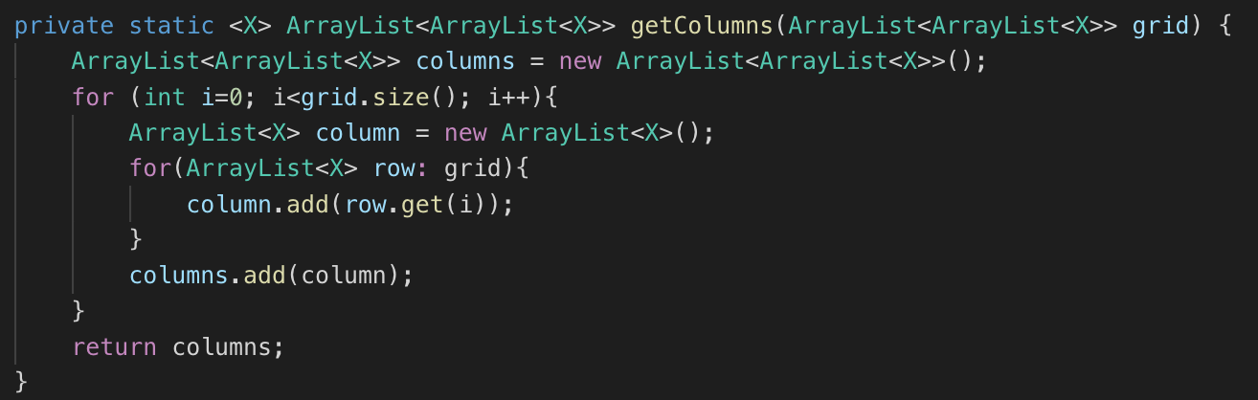
Getting the rows and columns

Slide 8
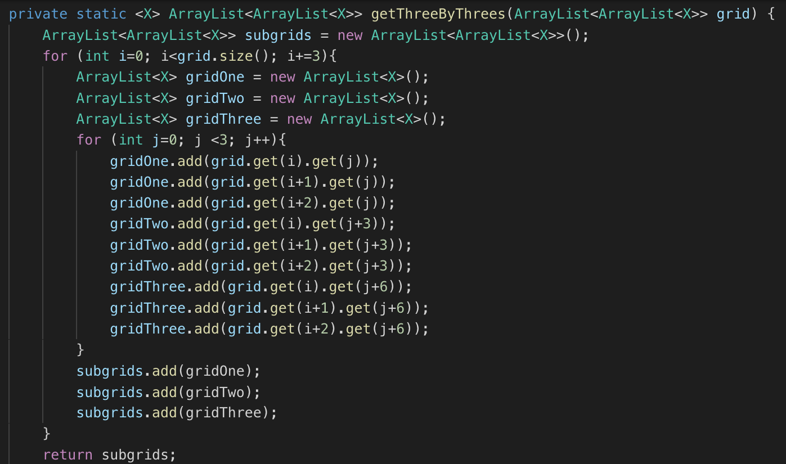
Getting the 3x3 sub-squares

Slide 9
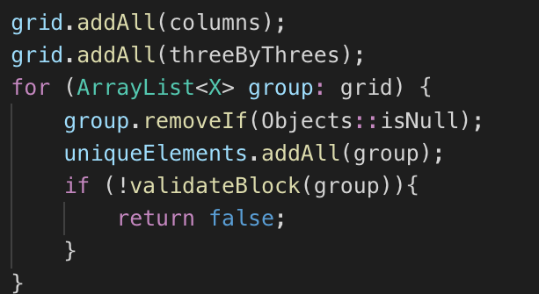
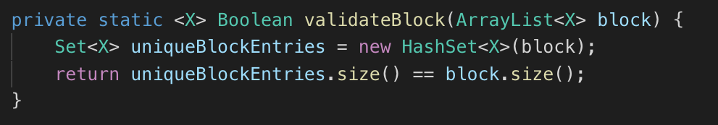
Is each group valid?

Slide 10
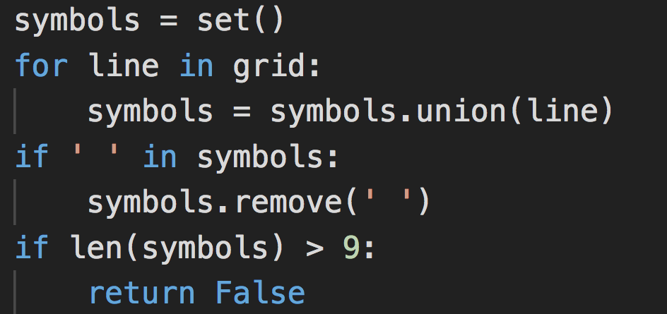
More than 9 characters?

Slide 11
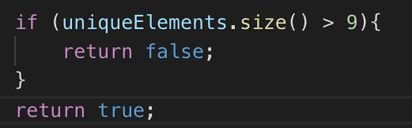
More than 9 characters?

Slide 12
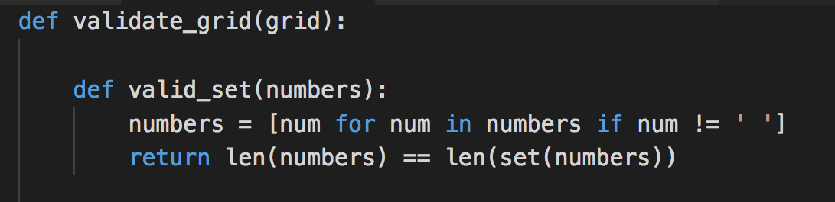
Deduplication

Slide 13
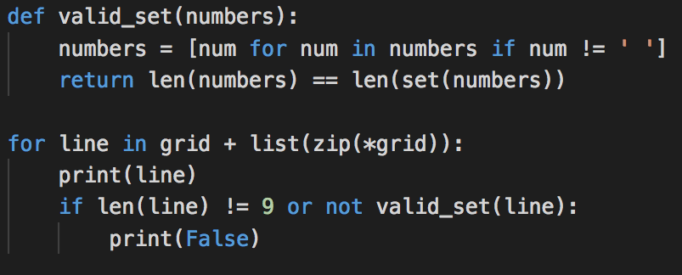
Zipping it

Slide 14
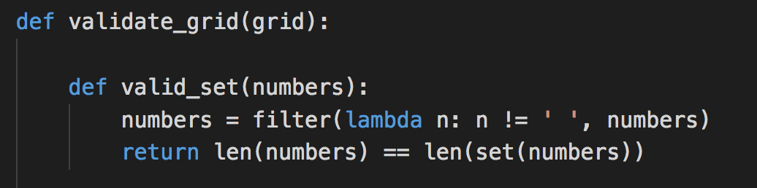
Without list comprehension

Slide 15
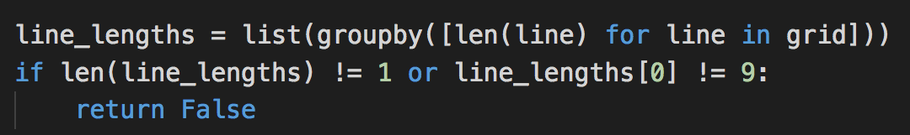
groupby() to check line lengths?

Slide 16
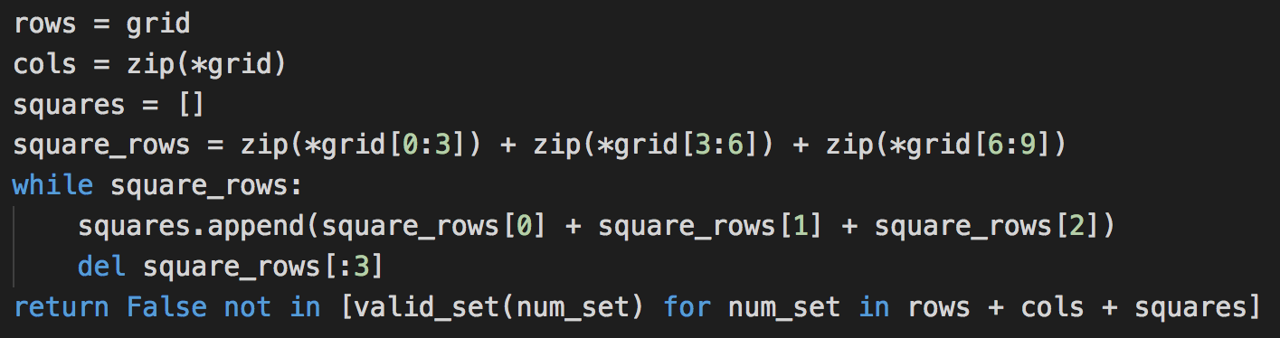
zip()-edy doo dah!

